Slide 1


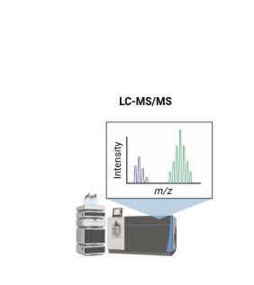
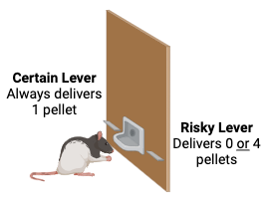
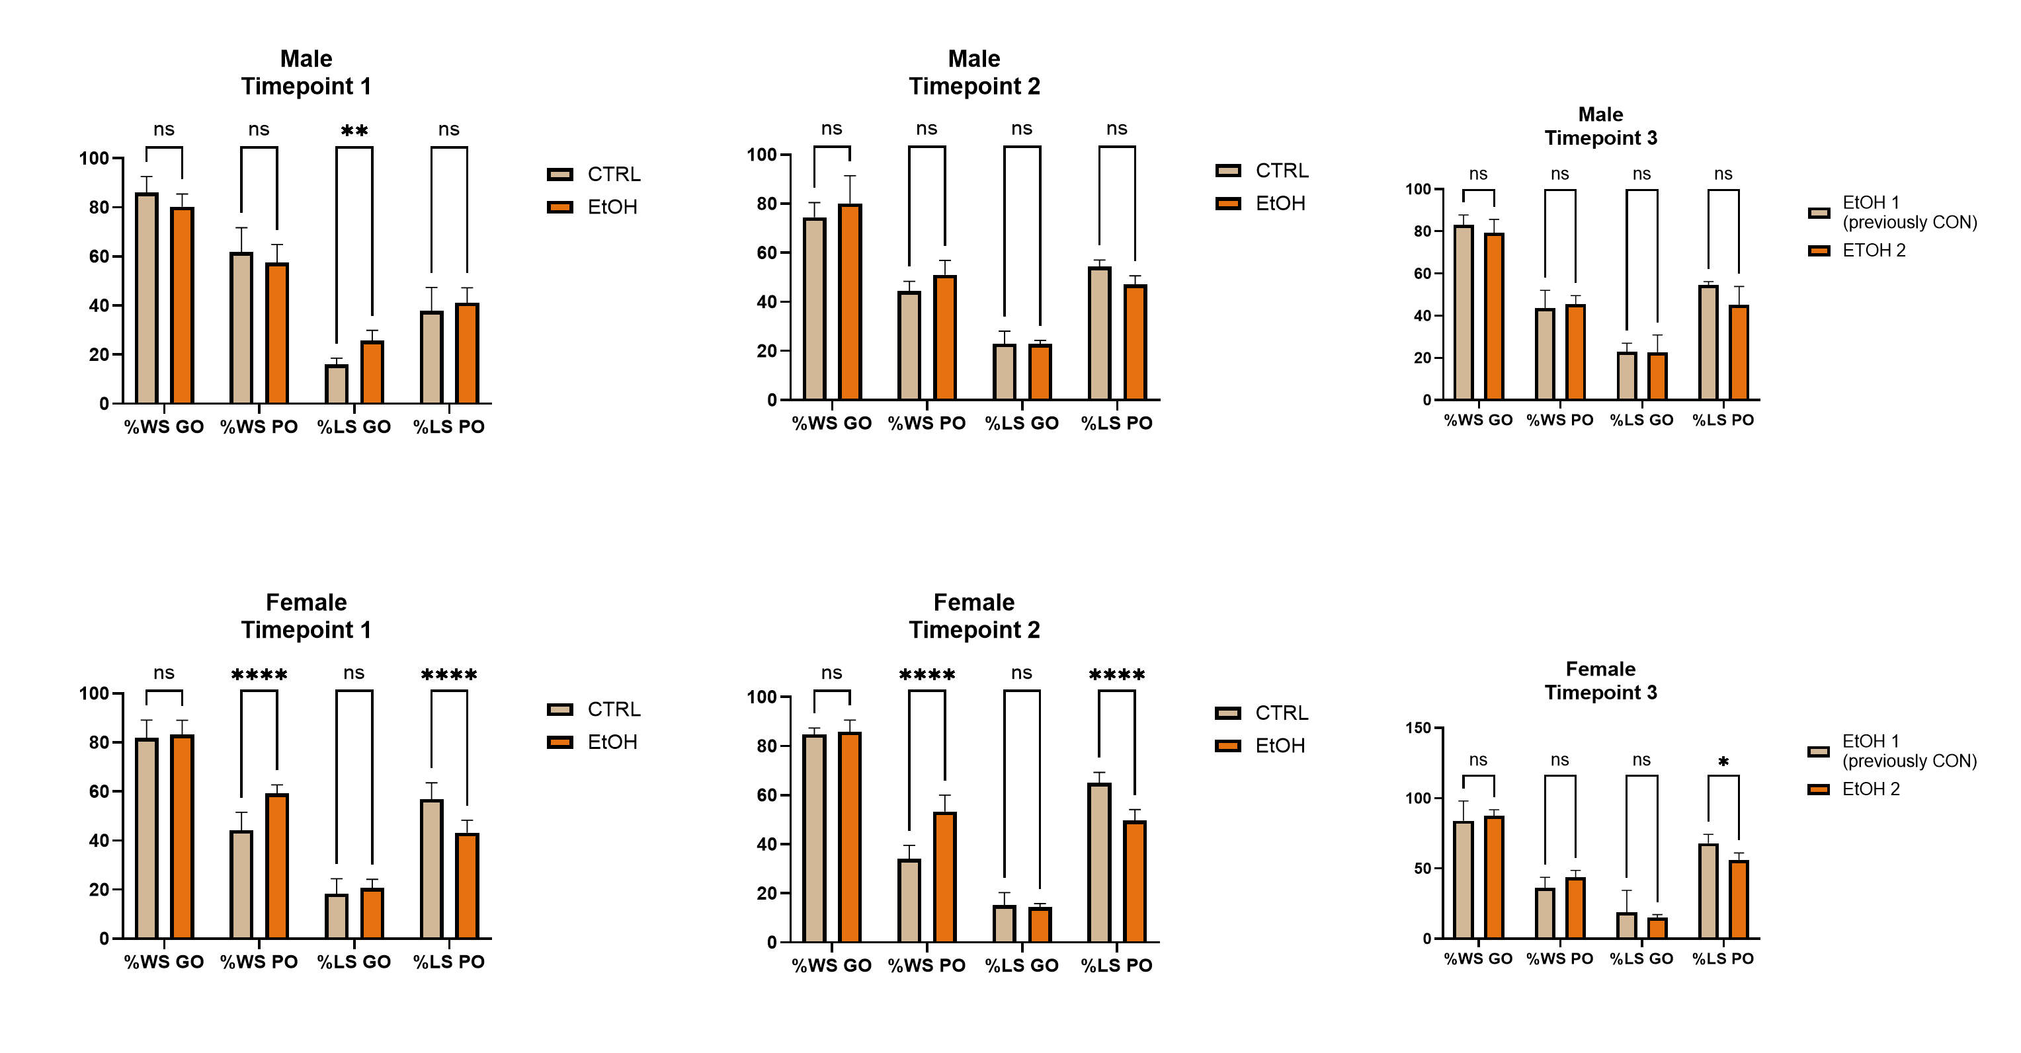
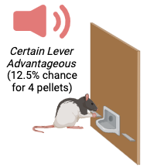
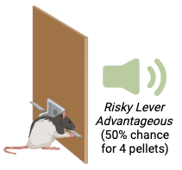
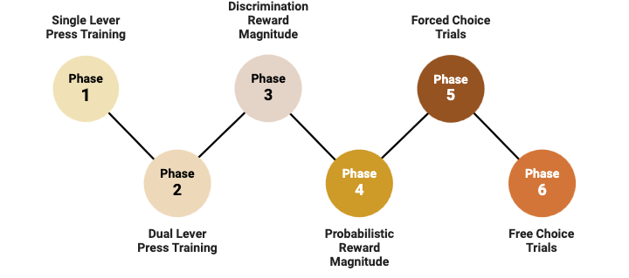
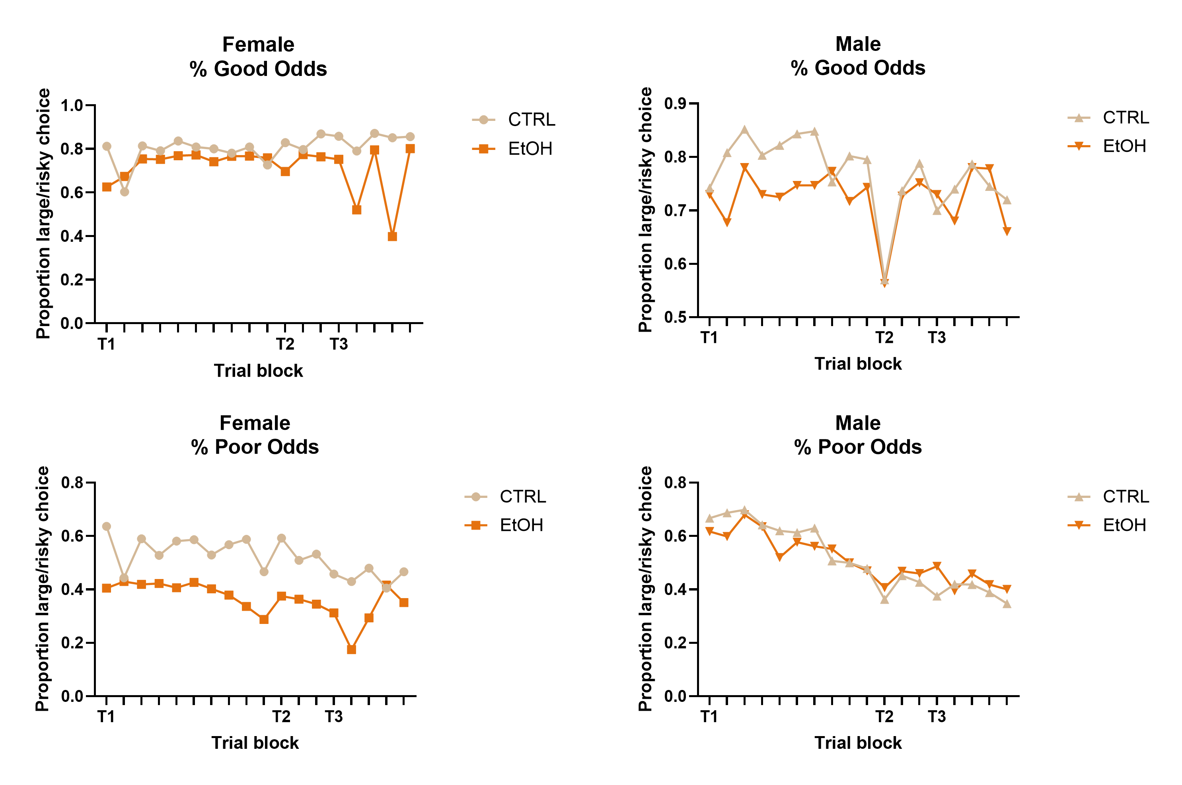
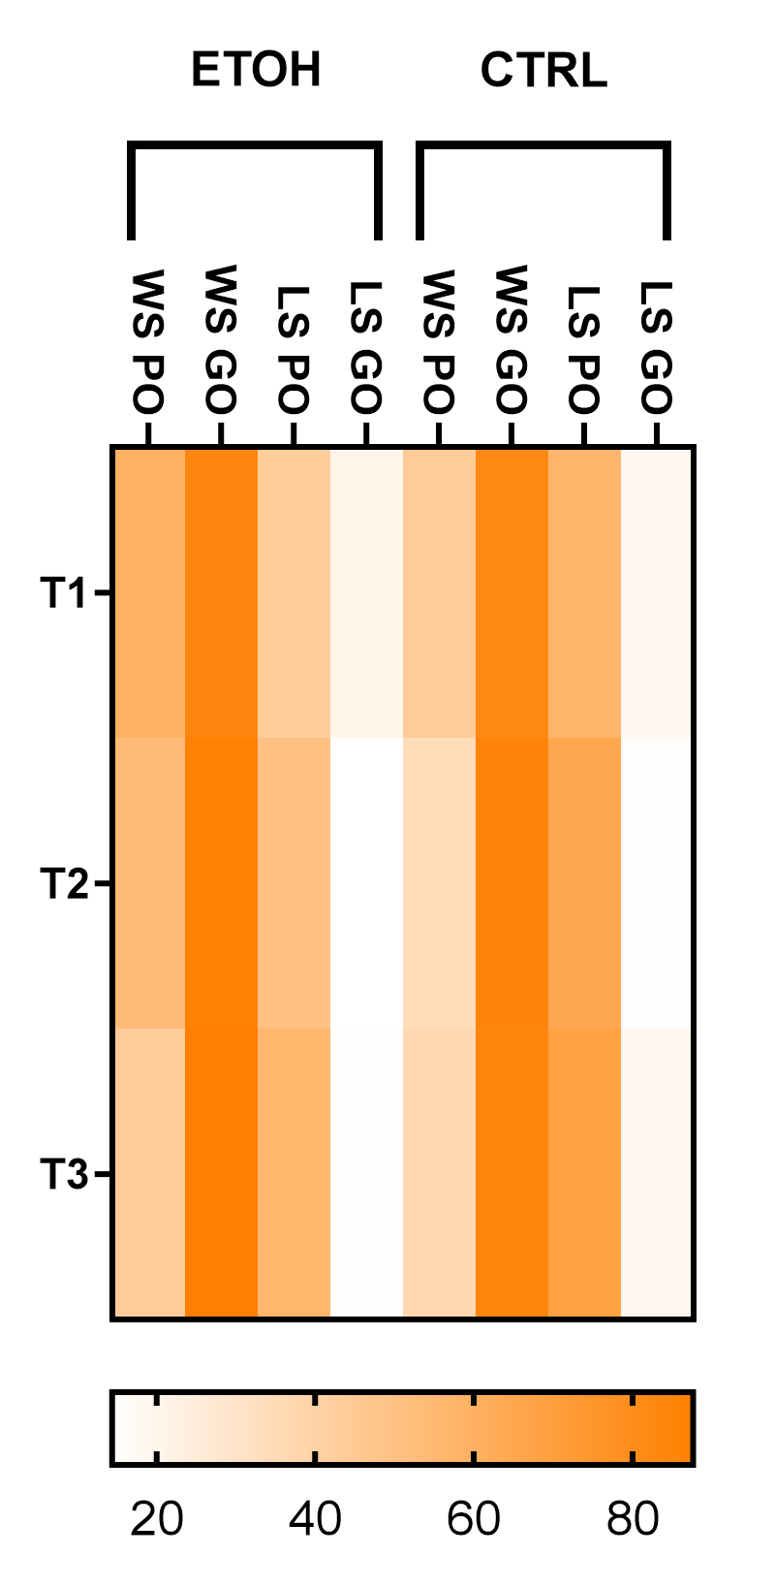
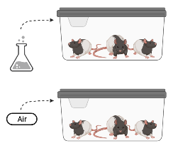
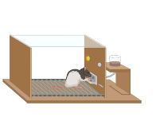
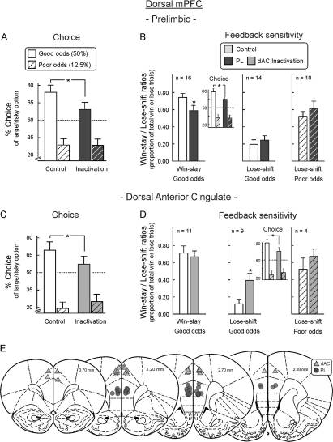
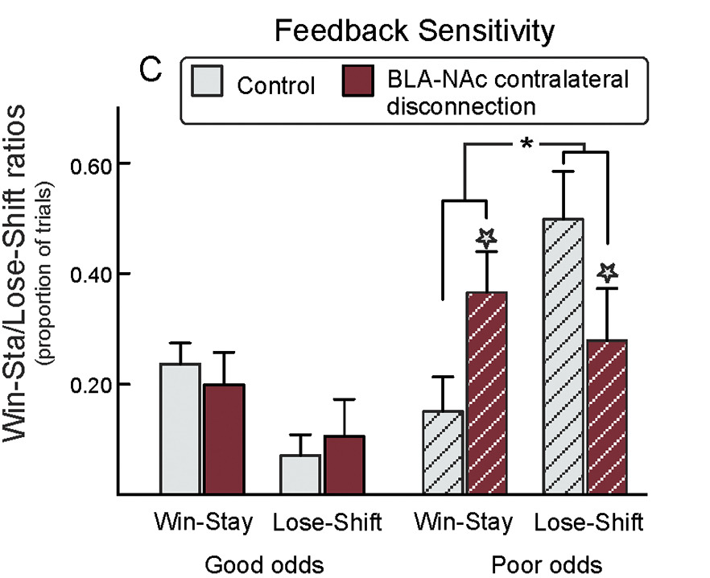
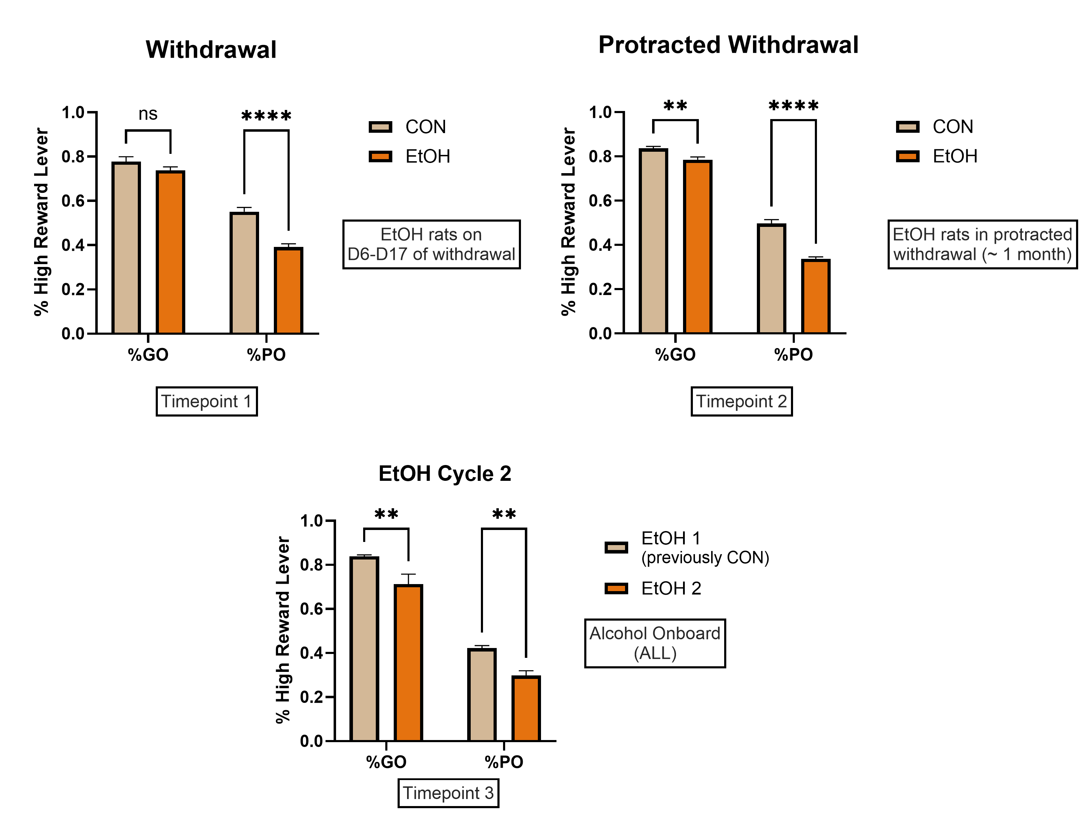
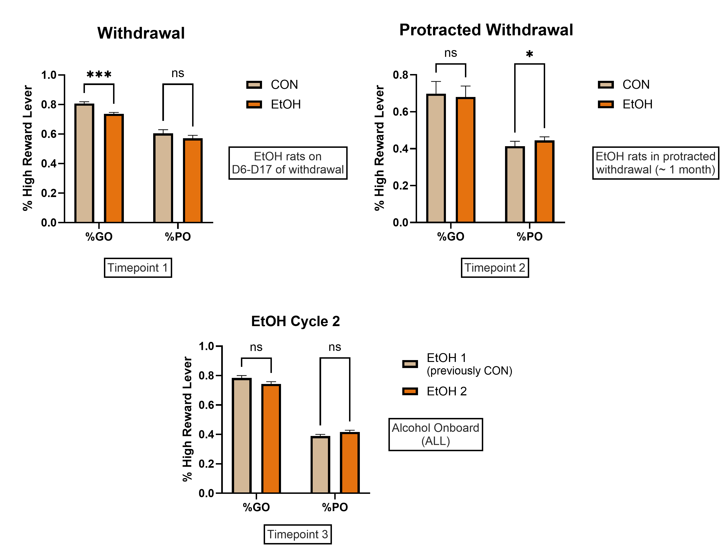
ASSESSING THE IMPACT OF ALCOHOL DEPENDENCE IN A RAT MODEL OF CUE-GUIDED RISKY DECISION-MAKING ACROSS SEXES
Joyradyn James-Rollins¹, Abby Askins¹, Stan B. Floresco², Luis A. Natividad¹
¹The University of Texas at Austin, College of Pharmacy, Division of Pharmacology and Toxicology
²Department of Psychology and Djavad Mowafaghian Centre for Brain Health, University of British Columbia
https://sites.utexas.edu/natividad/
Contact: Luis.Natividad@austin.utexas.edu
Introduction
“Blackjack” Task Paradigm
III. Win/Stay – Lose/Shift Game Theory Analysis
Alcohol Use Disorder (AUD) affects millions worldwide, severely impacting individuals and their families. Chronic alcohol and substance abuse have been linked to various health concerns, including cognitive dysfunction, which alters adaptive and decision-making processes that may underlie the difficulties one experiences in discontinuing drug use^{1,2}.
Our earlier work characterized the emergence of cognitive deficits caused by chronic intermittent ethanol (CIE) exposure in rats, particularly during abstinence. These impairments are long-lasting and involve dysfunction in cortical regions like the medial prefrontal cortex (mPFC), with research also suggesting that substance use disrupts processes that include the basal ganglia and nucleus accumbens. Specifically, we and others have observed that abstinence from CIE exposure impairs adaptive performance in an operant model of strategy set-shifting^{3,4,5}.
Recently, we explored the role of mu-type opioid receptors (MOR), given that naltrexone (NTX), a non-selective opioid receptor blocker, is widely used in treatment. Our findings revealed a deficiency in MOR phosphorylation in dependent rats exhibiting cognitive inflexibility. Building on this, we have continued our research by stimulating animals with DAMGO and CTAP to determine whether modulation can restore normal behavior during abstinence.
To further examine alcohol-driven behavior, we implemented the “Blackjack Task,” a novel cue-guided, risk-based decision-making assay designed to mimic real-world challenges faced by individuals with addiction. Our initial experiments with a male cohort revealed behavioral patterns like brain inhibition studies from other research teams^{7,8,}.To build on these findings, we aimed to determine whether similar behavioral patterns emerge in females.
A.
B.
C.
“Low Reward”
“High Reward”
Poor Odds Trial
D.
E.
F.
Good Odds Trial
G.
H.
K.
Methods
Created with BioRender.com
Chronic Intermittent Ethanol Exposure
I.
J.
“Pretraining” in
Operant Boxes
Operant Testing
During Abstinence
EtOH
Figure 3. Abstinence from CIE Exposure Disrupts Risk-Based Decision-Making Strategies, Leading to Suboptimal Performance. Win/Stay-Lose/Shift analysis was conducted on data from the “Blackjack” test using R coding software. Three timepoints were analyzed: Timepoint 1 represents early withdrawal (Days 6–17 of abstinence), Timepoint 2 represents protracted withdrawal (~1 month into abstinence), and Timepoint 3 represents the second EtOH consumption cycle, which occurred immediately after the last testing day in Timepoint 2. (A–C) Illustrate male performance across the three timepoints, where dependent rats exhibited an increase in shifting behavior during good-odds trials. (D–F) Depict female performance, showing a higher competency to repeat lever use during poor-odds trials throughout abstinence. (G–H) Represent the proportion of large/risky choice lever presses during good-odds trials across test days for both groups. (I–J) Display the proportion of large/risky choice lever presses during poor-odds trials across test days for both groups. (K) Presents a heatmap of female Win/Stay-Lose/Shift data, indicating that dependent females exhibited minor fluctuations in strategy across timepoints.
Statistical significance: *P < 0.05, **P < 0.001, ***P < 0.0001, ****P < 0.00001 (Two-way ANOVA).
Dorsal mPFC / Dorsal Anterior Cingulate
Liquid Diet
Created with BioRender.com
Phase 1 - 2
6-9 Days
Phase 3 - 5
CIE Exposure
6 Weeks
Phase 6
Free Choice Trials
10 Days
Final EtOH Exposure
T1
Early Withdrawal
T2
Protracted Withdrawal
T3
EtOH Re-Exposure
Conclusions
Testing Procedure/
Timeline
BLA -> NAc Shell Disconnection
Ethanol dependence is linked to a prolonged period of vulnerability to cognitive dysfunction, particularly in decision-making processes. Past work indicates that inactivation of the dorsal medial prefrontal cortex (mPFC), significantly reduces cue-guided risky-choice selection, highlighting its critical role in risk assessment and adaptive behavioral control.
Ethanol exposure dynamically alters risk-taking behavior, with effects varying by sex and period of abstinence. These effects of ethanol exposure are likely driven by disruptions within the brain's reward network.
Female dependent rats exhibited greater risk aversion overall, yet their performance remained suboptimal, as highlighted by the Win/Stay-Lose/Shift analysis. Their behavior closely mirrored that of rats with contralateral disconnections between the basal ganglia and nucleus accumbens.
Male rats displayed increased risky behavior during protracted withdrawal. In this late abstinence period, they also exhibited a shift in decision-making strategy, resembling patterns observed in animals with dorsal anterior cingulate inhibition.
Re-exposure to ethanol reduced risk-taking in dependent male rats, while in females, it appeared to correct task strategy, leading to more optimal performance. This suggests that alcohol may temporarily remediate cognitive dysfunction, potentially due to neuroadaptations induced by repeated alcohol exposure.
Our previous study found that naltrexone (NTX) did not significantly alter error-prone behavior in dependent rats, particularly when strategy shifts were beneficial. However, naltrexone did decrease behavioral engagement, indicating a blunting of internal motivation factors that contribute to performance. We aim to replicate this procedure and further investigate how naltrexone and other mu-opioid modulators affect decision-making and behavior.
D6 – D17
~ 1 Month
Following T2
Holstein and Floresco, 2019 Neuropsychopharmacol. 5(4):683–693.
Holstein and Floresco, 2019 Neuropsychopharmacol. 5(4):683–693.
LD
Free Choice Trials
II. Free Choice Trials “Blackjack” Task during EtOH Abstinence & Reintroduction
I. Chronic Intermittent Ethanol Exposure
Female
Male
Figure 2. CIE vapor exposure reliably induces EtOH dependence. Data depict the concentration of EtOH (mg/dL) in blood plasma (blood EtOH levels= 191.25±7.51 mg/dL) during 6 weeks of CIE vapor exposure (14h/d, 5d/week) (A) relative to subjective intoxication ratings (B) collected in rats which were later given the opioid receptor antagonist naltrexone (NTX) or vehicle (VEH) injections (n=15-16/grp). A correlation of intoxication ratings and BALs showed a similar positive association in both treatment groups (p<0.0001). EtOH rats also demonstrated similar increases in withdrawal signs (C) (vocalization, hyperirritability, ventromedial limb retraction, tail rigidity, abnormal gait, and tremors) as compared to air-exposed controls (CON) 8-10h into abstinence (****p<0.0001).
Figure 2. Abstinence from CIE Exposure Differentially Affects Risky-Choice Behavior in Male and Female Long-Evans Rats. Data shows the percentage of risky-choice selection for a high-reward lever during a cue-guided decision-making task. Distinct auditory cues signaled good- vs. poor-odds trials in rats exposed to a liquid diet containing either ethanol (EtOH) or an equi-caloric sucrose solution (CON) for 10 weeks (males: n=10/group, females: n=15/group). Dependent rats selected the high-reward lever less often on good-odds trials. Female rats also showed a significant reduction in high-reward selection on poor-odds trials throughout abstinence, whereas male dependent rats showed an increase during protracted abstinence. Statistical significance: *P < 0.05, **P < 0.001, ***P < 0.0001, ****P < 0.00001 (Two-way ANOVA).
ACKNOWLEDGMENTS: The authors are grateful for funding provided by the National Institute on Alcohol Abuse and Alcoholism (K99/R00-AA025393) and the UT Austin College of Pharmacy. The authors are grateful for assistance from the small-molecule mass spectrometry core facilities at UT Austin and Dr. Ian Riddington.
REFERENCES: 1. Jansen et al., 2015, Addict Biol. 20(5):979-989. 2. Petit et al., 2017, PLoS One. 12(8): e0176638. 3. Natividad et al., 2018, Addict Biol. 23(5):1117-1129. 4. Trantham-Davidson et al., 2014, J Neurosci. 34(10):3706-3718. 5. Brady & Floresco, 2015, J Vis Exp. (96):e52387. 6. Dannenhoffer et al., 2021, Int. Rev. Neurobiol. 160(2021), pp. 132-133. 7. Holstein and Floresco, 2020, J Neuropsychopharmacol. 45(4), 683–693. 8. Holstein and Floresco, 2019 Neuropsychopharmacol. 5(4):683–693.

